Slide 1
Extractive metallurgy
Lecture 1
Extractive metallurgy is a discipline in engineering that deals with the extraction and refining of metals.
Metallurgy refers to the field of studying the chemical and physical properties of metals.

Slide 2
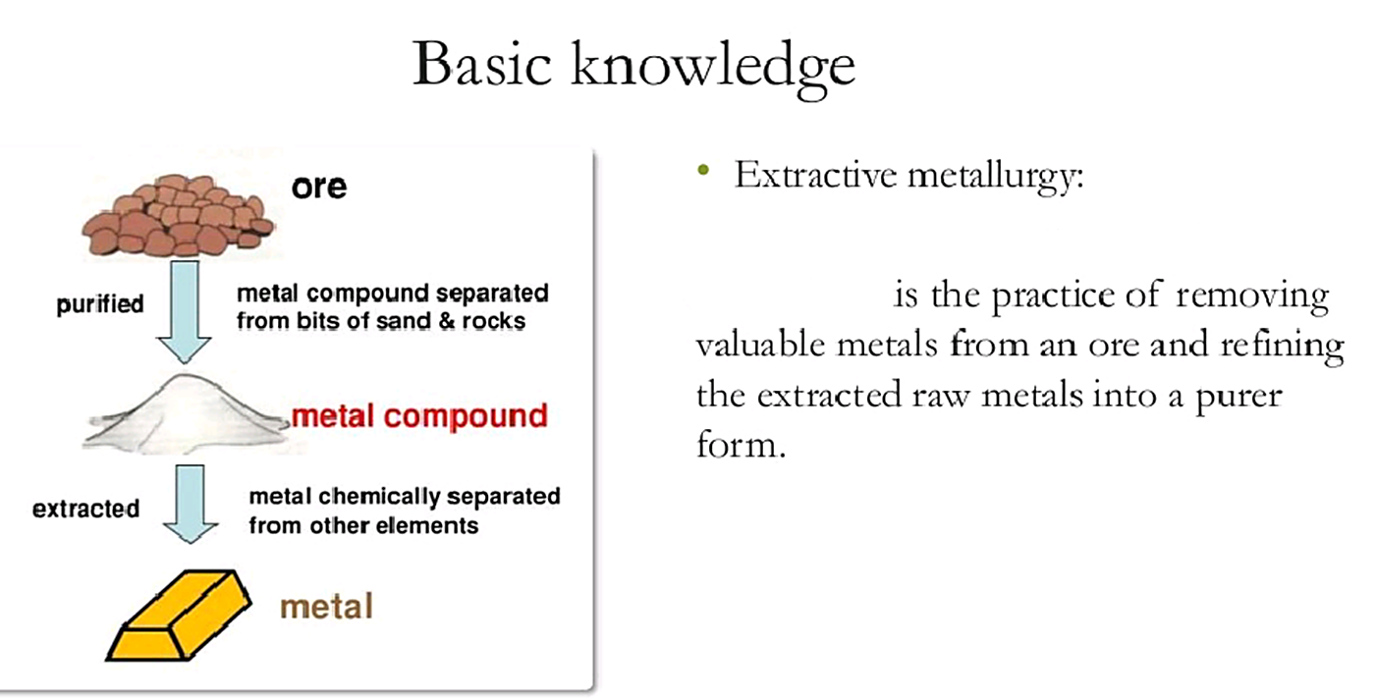

Slide 3
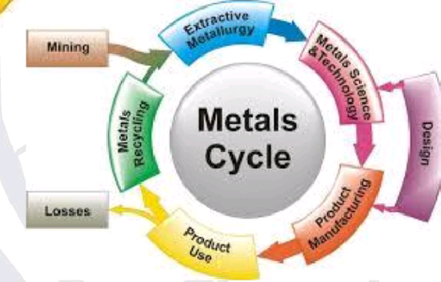

Slide 4
Basic terms
A mineral is a naturally occurring compound. Minerals are mostly inorganic compounds consisting of one or more metals in association with nonmetals like oxygen, sulfur, etc.
An ore is a naturally occurring aggregate of minerals. The ore may exhibit wide variation in composition and in physical and chemical characteristics (properties).
When ore deposits are exploited in extractive metallurgy there is generally some waste product. This waste is composed of some minerals in the ore which are not useful. These are known as gangue or gangue minerals.
Flux is a chemical cleaning agent used for purification of the ores.

Slide 5
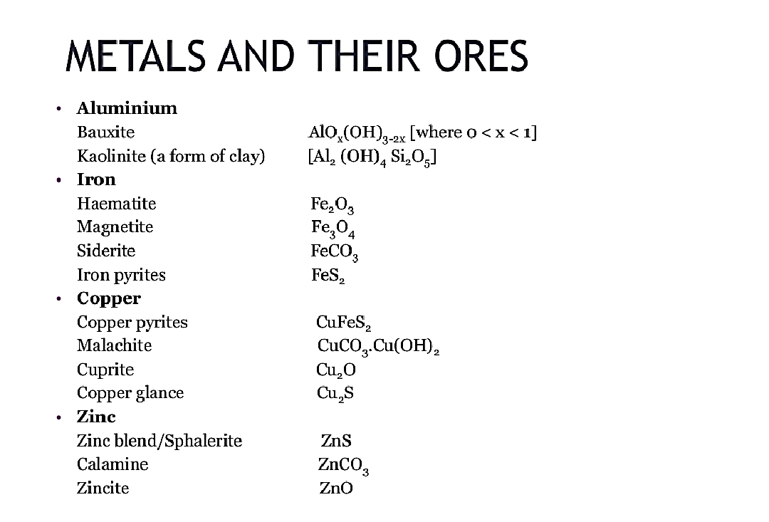

Slide 6
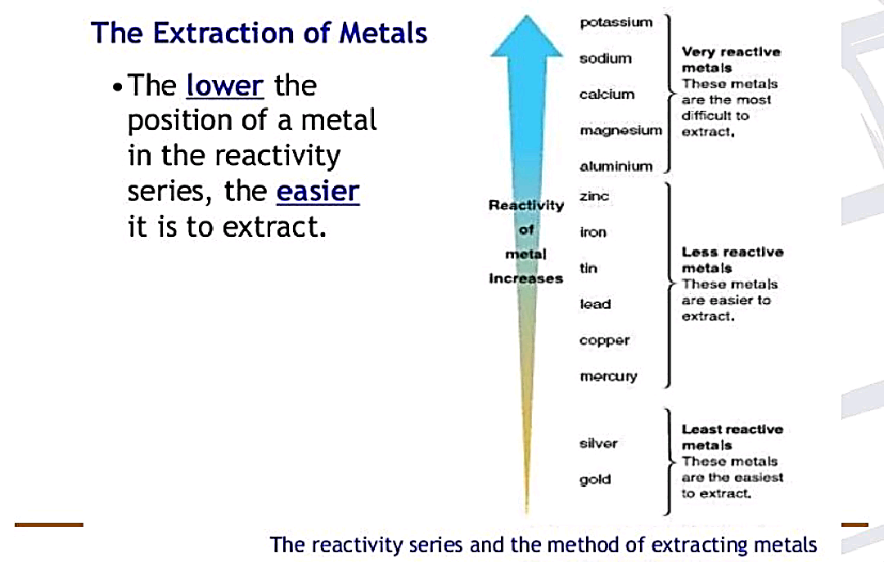
Naturally occurring minerals are mainly oxides, sulfides, silicates, which are the most abundant minerals and halides ( like chlorine or fluorine with a metal). These minerals form simple or complicated and stable ores depending on the chemical reactivity of metals.

Slide 7
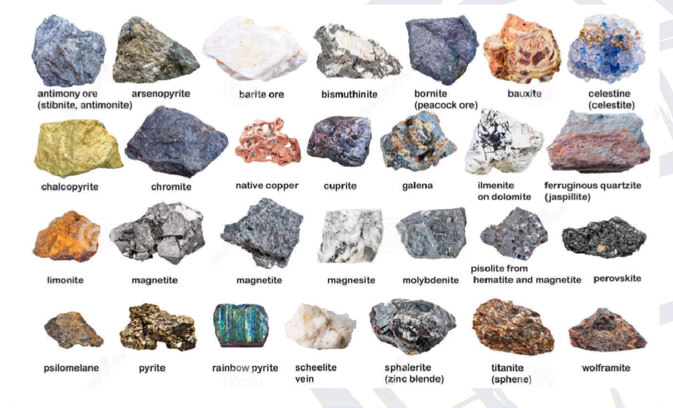

Slide 8
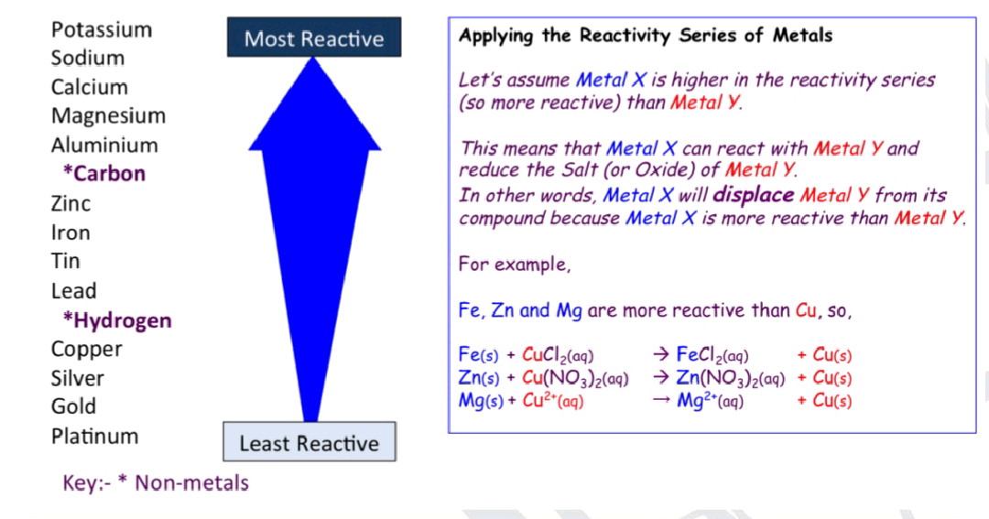

Slide 9
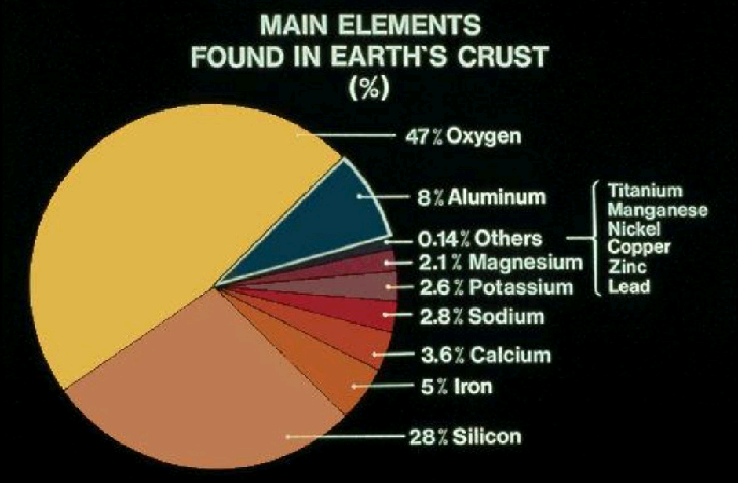
Sources of metals
Earth crust
Ocean water
Metallurgical waste or Metal scrap

Slide 10
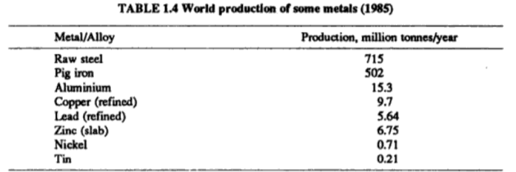
Commercial production of metals
So, ferrous extractive metallurgy comes from the great importance of iron and steel.

Slide 11
Methods of extraction of metals
Pyro metallurgy
Hydrometallurgy Will be explained in the next lectures
Electrometallurgy
Another way of classification, pyro metallurgy is classified as follows:
Solid state processing
Liquid state processing

Slide 12
Methods of extraction of metals
Solid state processing: This method doesn't involve any melting. Its carried out (applied) in the temperature range of 500 to 1200 °c through for example roasting of ore sulfides and calcination.
Liquid state processing: This process involves melting and its carried out at high temperatures through steel making and blast furnace smelting, etc.
*** steel ( low, medium, and high carbon steel)
(>1) Carbon

